Slide 1

Sales Forecasting for Furniture Store
Submitted by- Gaurav Rawat

Slide 2

Introduction
Welcome to the Sales Forecasting for Furniture Store project!
In this presentation, we will explore how time series analysis can be leveraged to forecast sales for a furniture store.
By accurately predicting future sales, we aim to optimize inventory management and ensure sustained business operations.
Join us on this journey as we delve into the world of time series data and uncover valuable insights for the furniture retail industry.
Let's begin our exploration of forecasting furniture sales and optimizing business strategies!

Slide 3

Problem Statement
Inventory Challenges: Furniture stores grapple with inventory issues like overstocking and understocking due to fluctuating demand and seasonal trends.
Need for Accuracy: Accurate sales forecasting is essential to address these challenges, enabling optimal inventory management and cost reduction.
Business Sustainability: Precise forecasting ensures business sustainability by improving customer satisfaction, sales revenue, and overall profitability.

Slide 4
Dataset Overview
Introduction to the Dataset: The dataset comprises detailed information on furniture sales, encompassing transaction specifics and customer demographics.
Data Variables: Core variables include Row ID, Order ID, Order Date, Ship Date, Ship Mode, Customer ID, Customer Name, Segment, Country, City, and more, providing a comprehensive view of each transaction.
Data Preprocessing: Prior to analysis, the dataset undergoes preprocessing stages such as cleaning, handling missing values, and formatting to ensure data quality and consistency.

Slide 5

Data Preprocessing
Cleaning
Data cleaning
Identify and handle missing values (e.g., fill with mean/median, remove rows)
Correct inconsistencies (e.g., standardize formats)
Remove outliers (e.g., transactions with extremely high amounts)
Engineering
Feature engineering
Create new features from existing data (e.g., difference between past and current balance)
Encode categorical variables (e.g., one-hot encoding for transaction types)

Slide 6
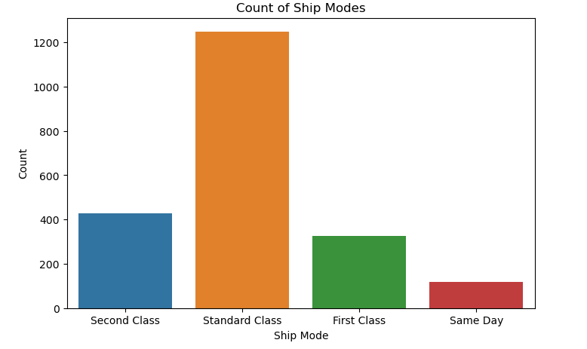
Data Visualization
Bar chart of Ship Mode counts

Slide 7
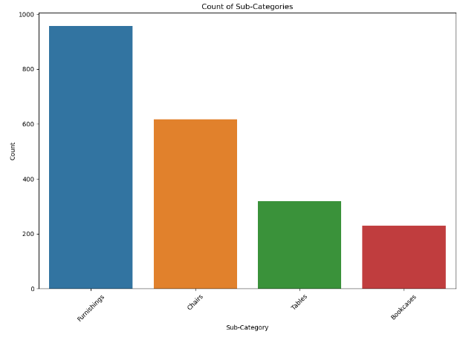
Count plot of Sub-Category

Slide 8
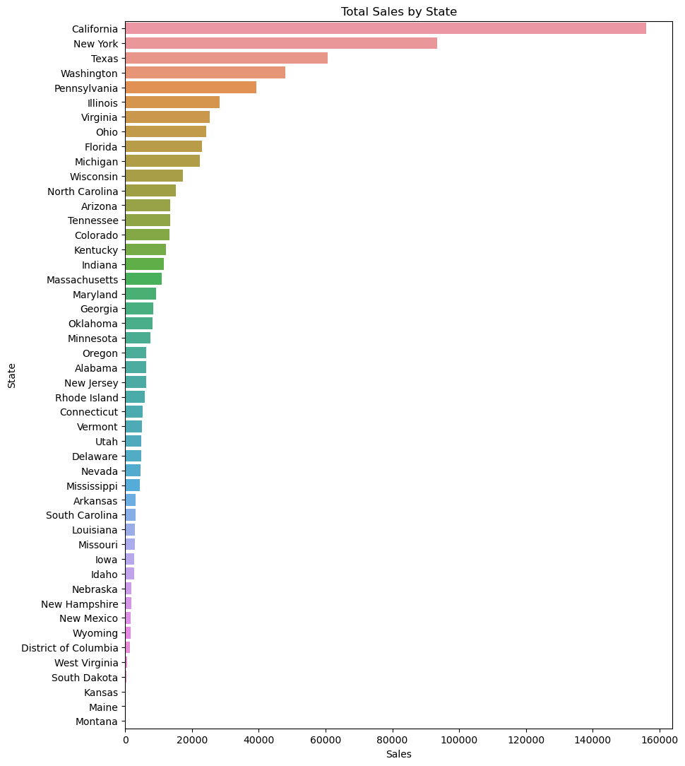
Total Sales by State

Slide 9
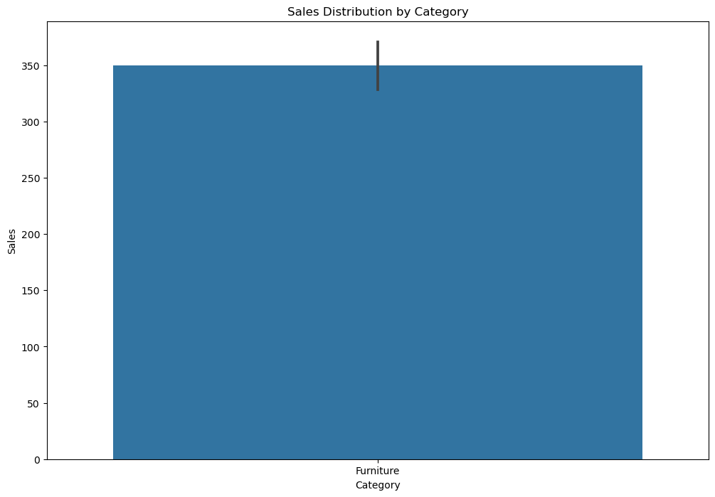
Sales Distribution by Category

Slide 10
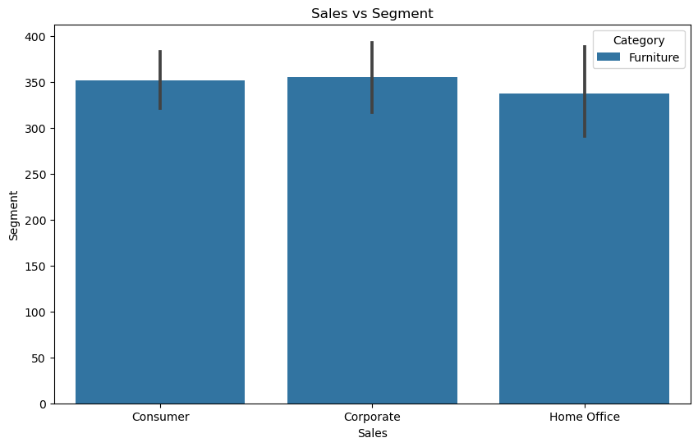
Line plot of Sales vs Segment

Slide 11
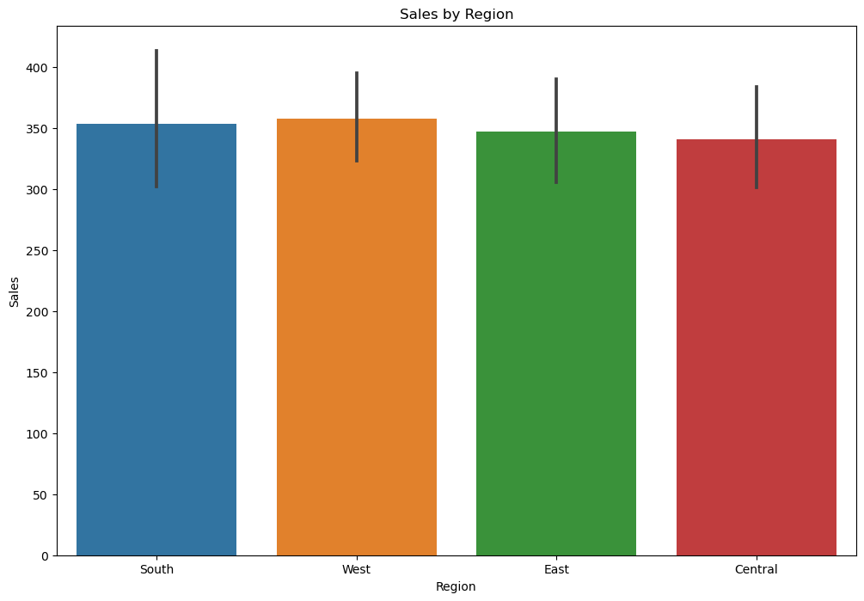
Sales by Region

Slide 12
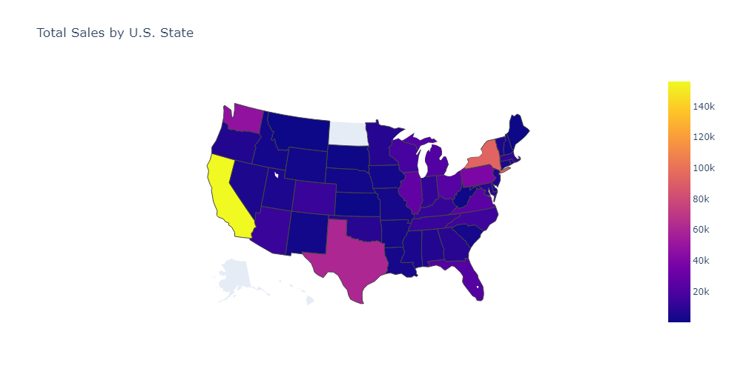
Total Sales by U.S. State

Slide 13
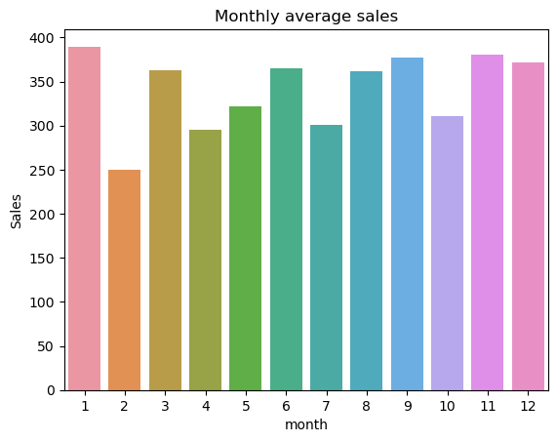
Time Series Analysis
Monthly average sales

Slide 14
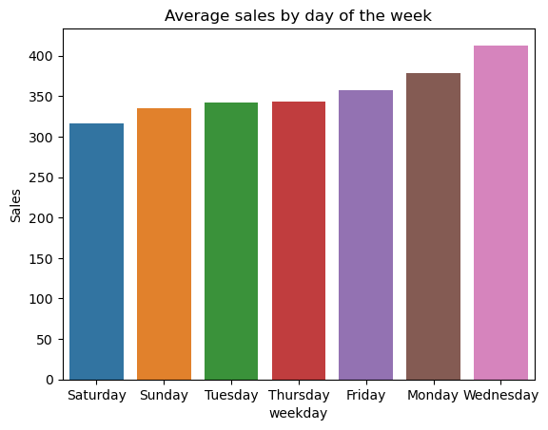
Average sales by day of the week

Slide 15
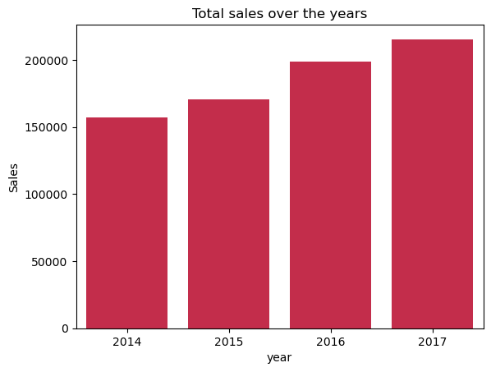
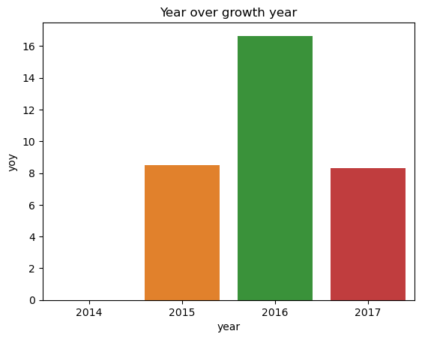
Total sales over the years Year over growth year

Slide 16
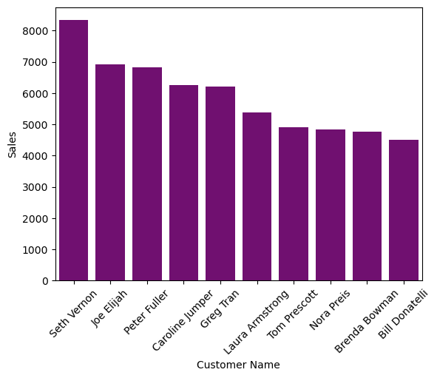
Top 10 customers

Slide 17
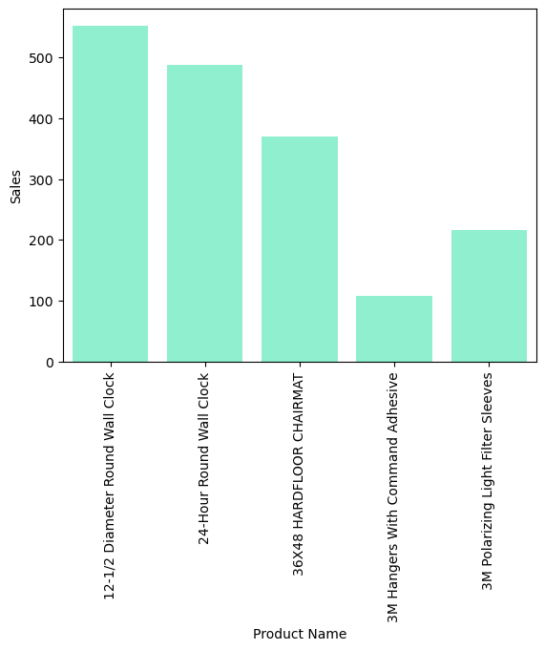
Top selling items of all times

Slide 18
Conclusion
Revenue Growth: Consistent revenue growth was observed, with spikes in November attributed to Black Friday. Declines post-January indicate seasonal trends.
Customer Segmentation: Identified three primary segments: Consumer, Corporate, and Home Office. Further analysis could inform targeted marketing strategies.
Category Analysis: Technology, Furniture, and Office Supplies were top revenue generators. Focus on Technology sub-categories may unveil growth opportunities.
Valuable Customers: Recognized top customers contributing to revenue. Implement personalized marketing tactics for customer retention.
Average Order Value Stability: Stable average order value indicates consistent customer spending patterns.
Recommendations:
Offer promotions to stimulate sales.
Increase stock of staple items.
Decrease inventory of products with fewer than 5 sales.
Focus marketing efforts on Binders and Papers.
Limit exports of expensive Technology products due to low sales.
Provide discounts on rarely sold products to boost sales.

Slide 19

THANK YOU

